Slide 1

World Wide Energy Consumption
Katlagunta Rajesh [B. tech (CSE)]

Slide 2




Energy Consumption
Analysis
A Data-Driven Exploration of Global Energy Trends Using SQL

Slide 3
Objective of the Project
The main objective of this project is to analyze global energy data like emissions, production, consumption, GDP, and population to derive meaningful insights into energy trends, economic impact, and environmental performance of countries.
Identify top contributors to emissions and energy use
Examine time-series trends (GDP, emissions, energy consumption)
Perform ratio and per-capita analysis
Deliver actionable insights for policymakers, analysts, and businesses

Slide 4
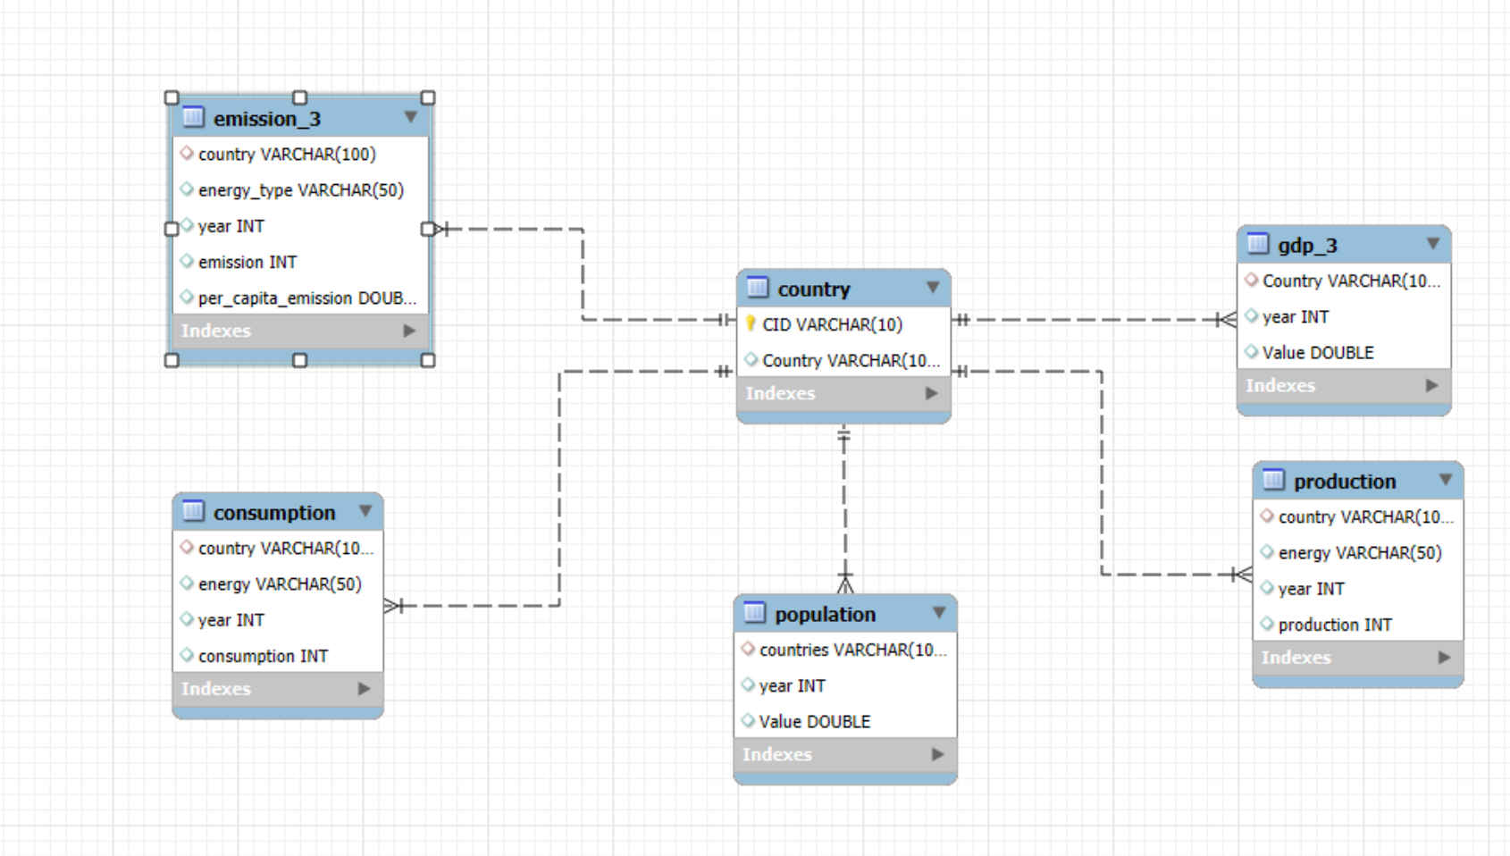
ER Diagram and schema explanation

Slide 5
Entities and Relationships
Country → Master table for unique countries (CID, Country)
Emission_3 → Yearly emissions data by energy type (FK → country)
Population → Yearly population data per country (FK → country)
Production → Yearly energy production per country (FK → country)
Gdp_3 → Yearly GDP per country (FK → country)
Consumption → Yearly energy consumption per country (FK → country)
Note: All tables reference country.Country as foreign key.

Slide 6
Key analysis questions (use cases)
General: Emissions by country, Top GDP, Top energy emitters
Trends: GDP trend, Pop vs. emissions, Per-capita emission change
Ratios: Emission/GDP, Consumption per capita, Production per capita
Global: Pop vs. emissions, Global Emission share %

Slide 7
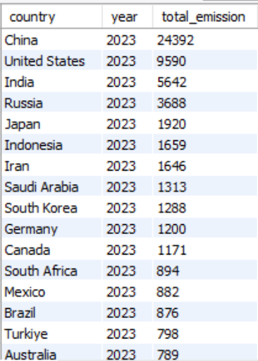
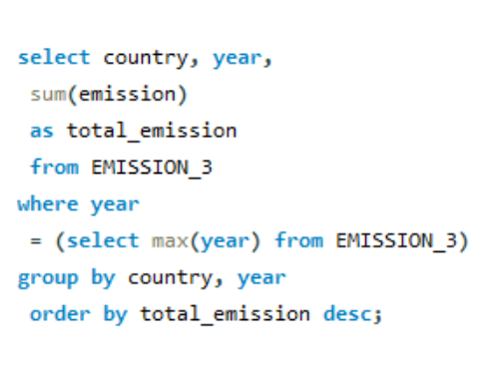
SQL Query Results With Screenshots 1. What is the total emission per country for the most recent year available?

Slide 8
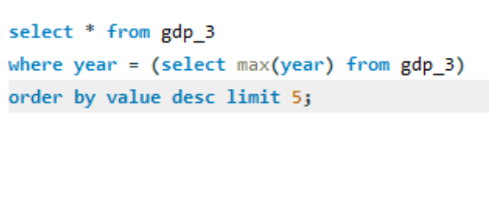
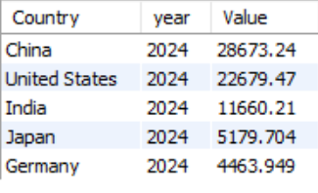
2. What are the top 5 countries by GDP in the most recent year?

Slide 9
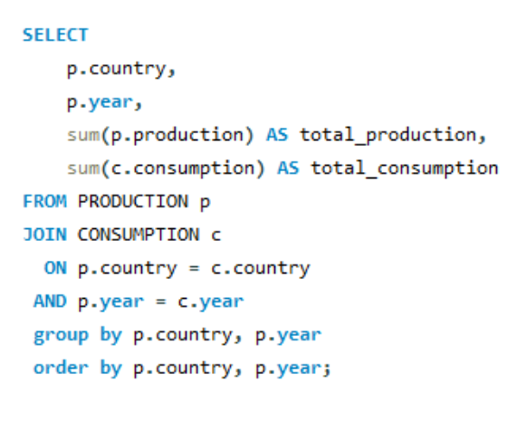
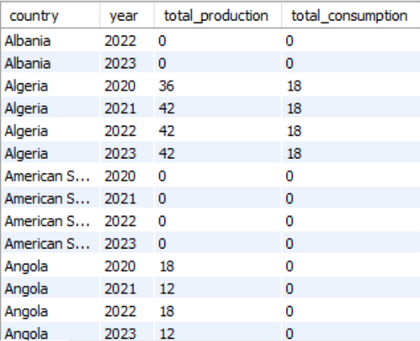
3. Compare energy production and consumption by country and year.

Slide 10
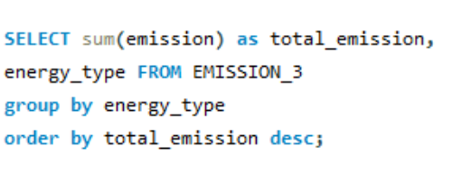
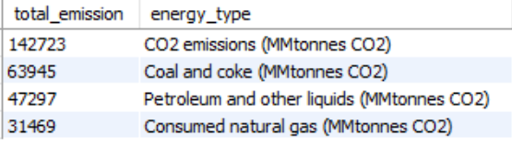
4. Which energy types contribute most to emissions across all countries?

Slide 11
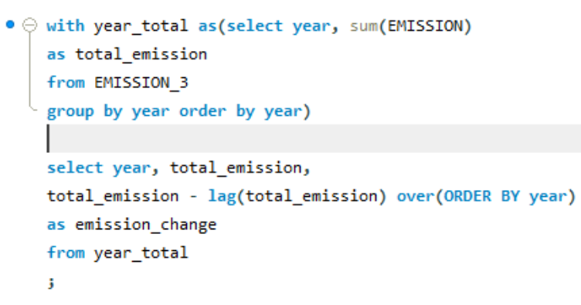
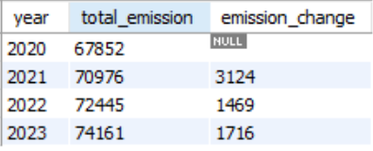
Trend Analysis Over Time
1. How have global emissions changed year over year?

Slide 12
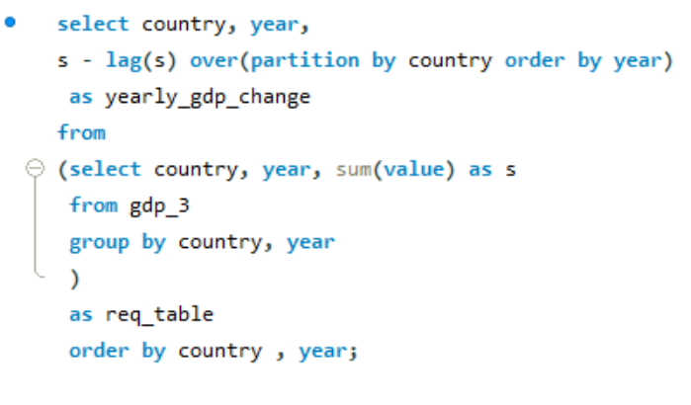
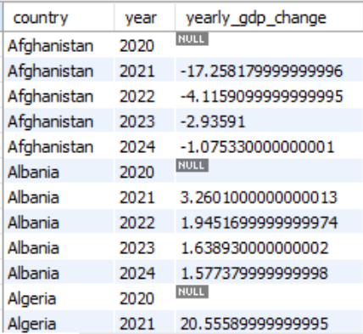
2. What is the trend in GDP for each country over the given years?

Slide 13
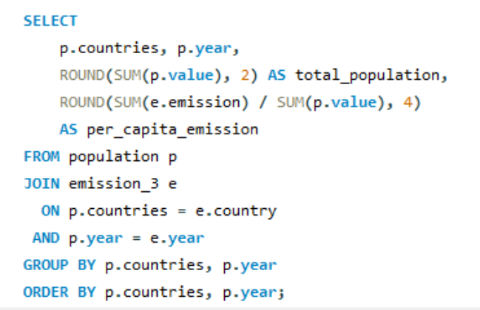
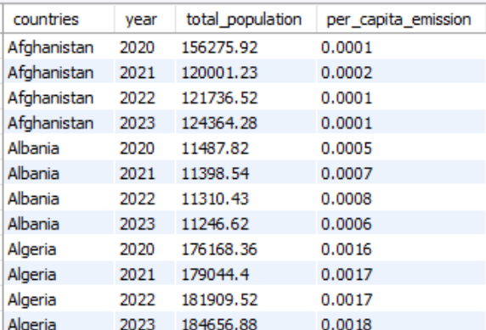
3. How has population growth affected total emissions in each country?

Slide 14
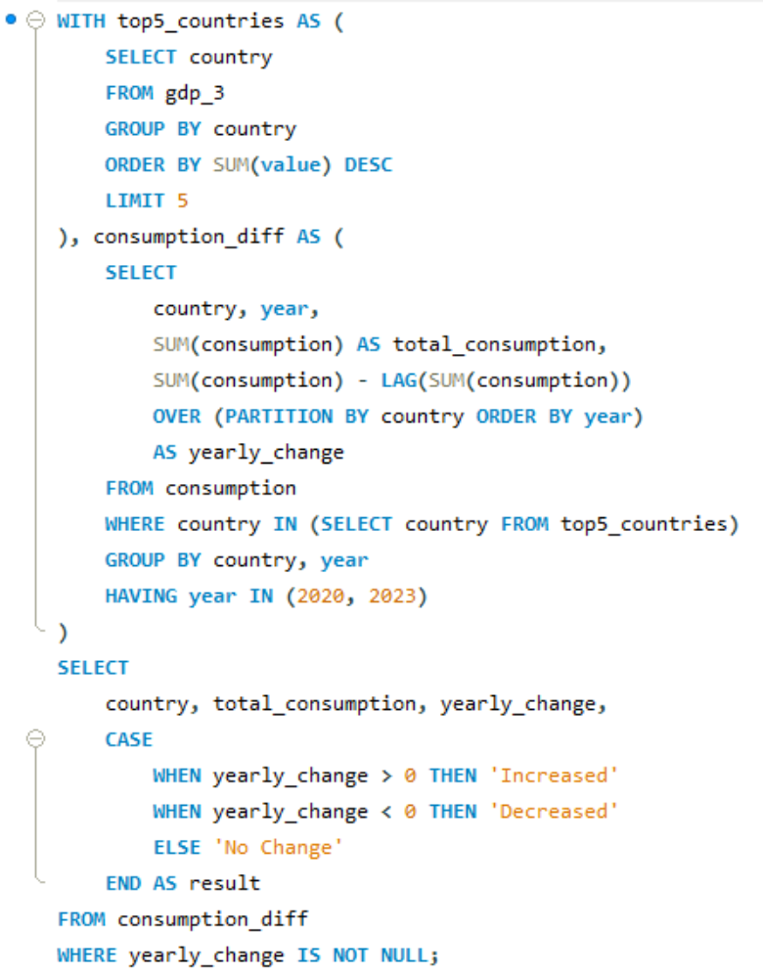
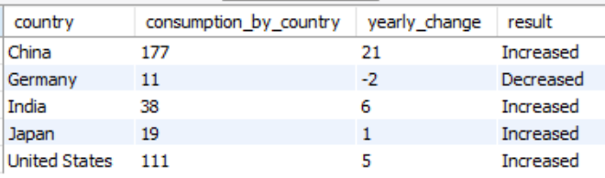
4. Has energy consumption increased or decreased over the years for major economies?

Slide 15
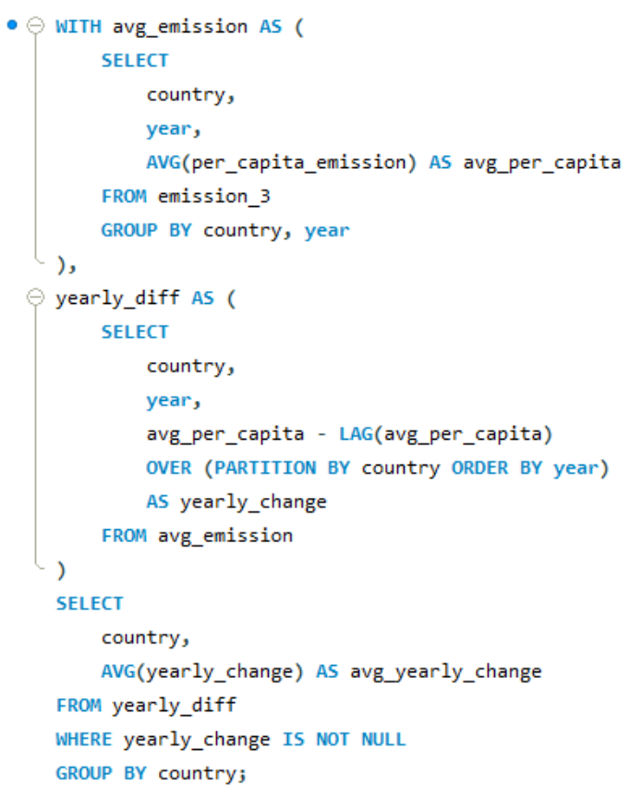
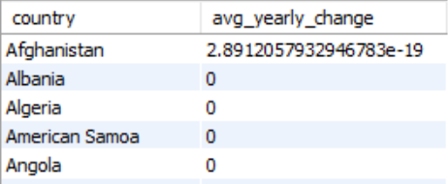
5. What is the average yearly change in emissions per capita for each country?

Slide 16
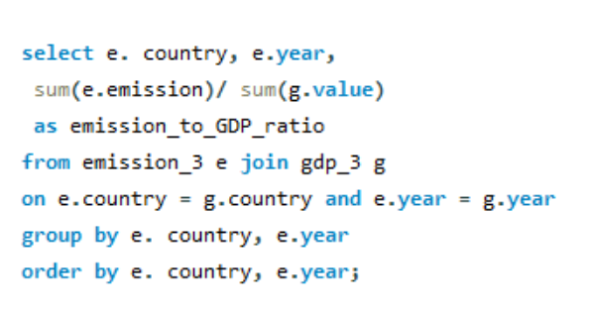
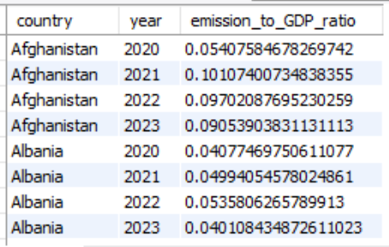
Ratio & Per Capita Analysis
1. What is the emission-to-GDP ratio for each country by year?

Slide 17
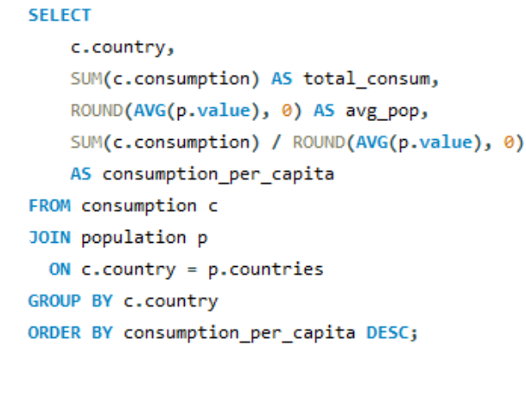
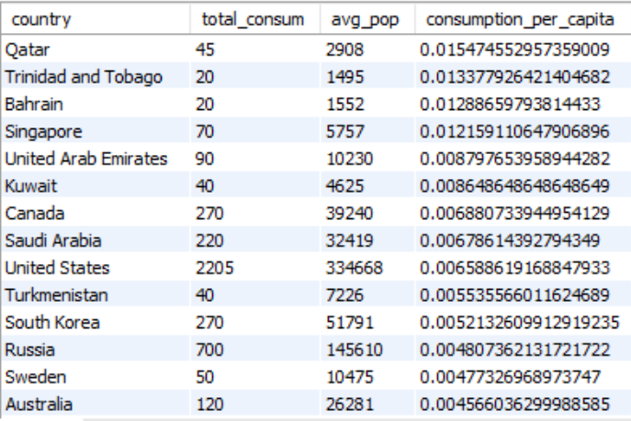
2. What is the energy consumption per capita for each country over the last decade?

Slide 18
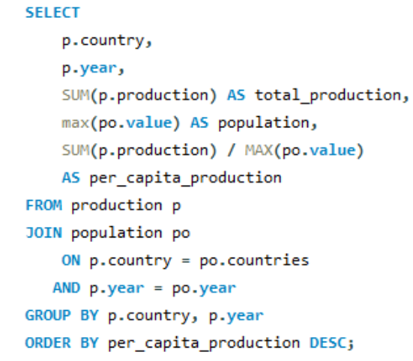
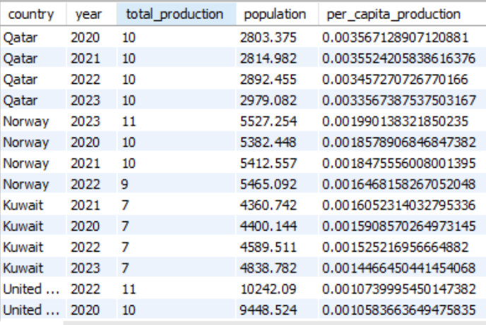
3. How does energy production per capita vary across countries?

Slide 19
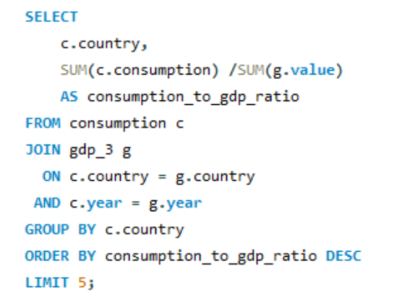
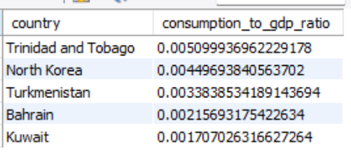
4. Which countries have the highest energy consumption relative to GDP?

Slide 20
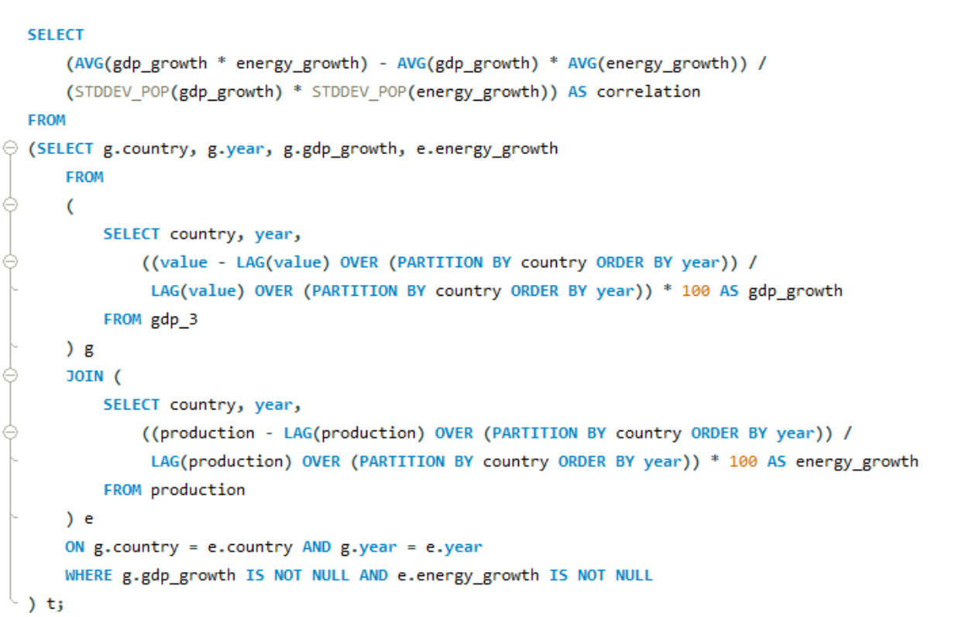
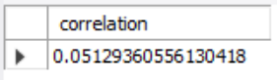
5. What is the correlation between GDP growth and energy production growth?

Slide 21
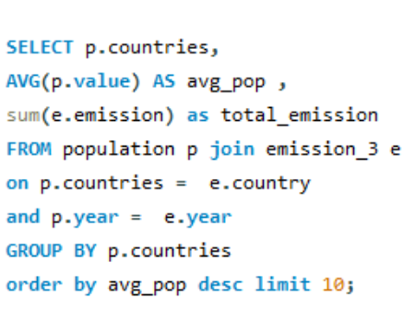
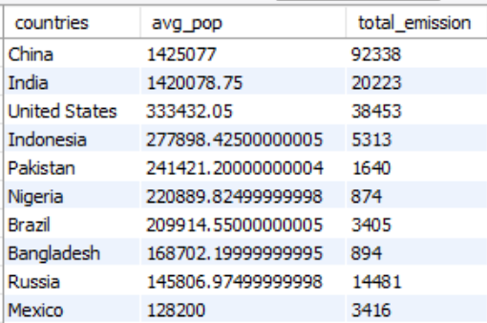
Global Comparisons
1.What are the top 10 countries by population and how do their emissions compare?

Slide 22
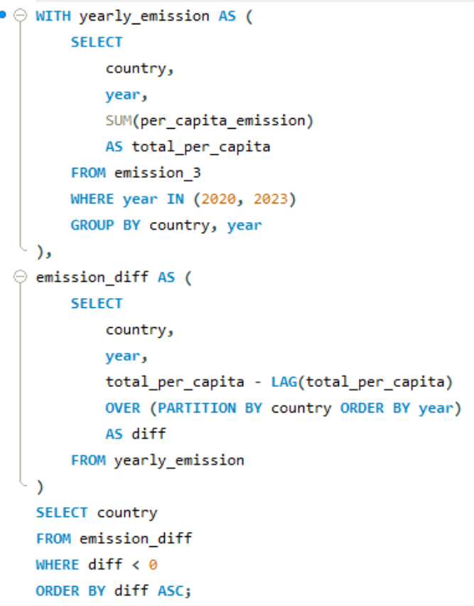
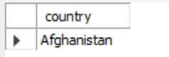
2. Which countries have improved (reduced) their per capita emissions the most over the last decade?

Slide 23
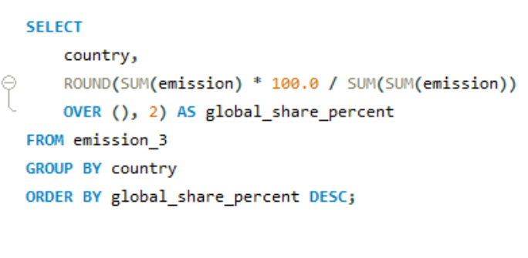
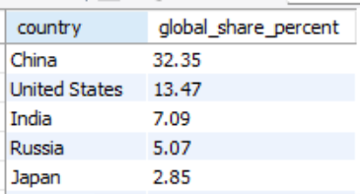
3. What is the global share (%) of emissions by country?

Slide 24
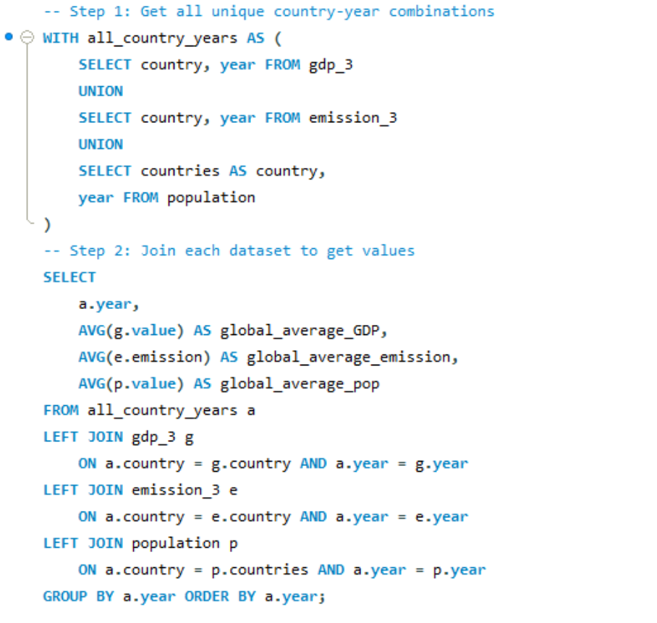
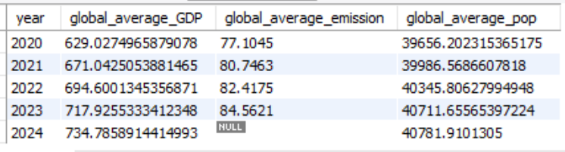
4. What is the global average GDP, emission, and population by year?

Slide 25
Final business insights and recommendations
Shift towards renewables: Countries with high emission-to-GDP ratios must accelerate clean energy adoption it was not up to the mark.
Energy efficiency investment: Nations showing high consumption/GDP ratio can reduce waste and costs.
Support developing economies: Assistance in cleaner technology can lower emissions without hurting growth.
Global collaboration: Top emitting nations should coordinate efforts, as they dominate global impact.
Long-term monitoring: Population and GDP trends should guide future energy policy.

Slide 26
Conclusion (Key findings overall)
Energy use and economic growth are tightly linked, but efficiency improvements are reducing emissions per GDP unit in many developed countries.
Transition to renewable energy is the key differentiator between nations improving vs. worsening per-capita emissions.
Data-driven decisions in energy investment, trade policy, and climate agreements are critical to sustaining growth while cutting emissions.

Slide 27
Your Experience/Challenges working on SQL – Data Analysis Project.
Experience:
Gained practical exposure to SQL joins, CTEs, window functions, aggregation.
Learned to translate business questions into SQL queries.
Improved understanding of data relationships
Challenges:
Ensuring country names match across tables
Handling NULLs and missing years in time series.
Writing complex queries with CTEs and window functions for year-over-year comparisons.
Interpreting ratios and growth trends without misrepresenting the data.

Slide 28
Question & Answer Slide

Slide 29

THANK YOU

